Slide 1
International Development White Paper

Slide 2
The White Paper in Numbers
464 responses to the call for evidence, totalling over 2400 pages
70 Posts ran consultations and contributed information
148 pages full of analysis, vision and commitments
217 “We will…” commitments to deliver by 2030

Slide 3
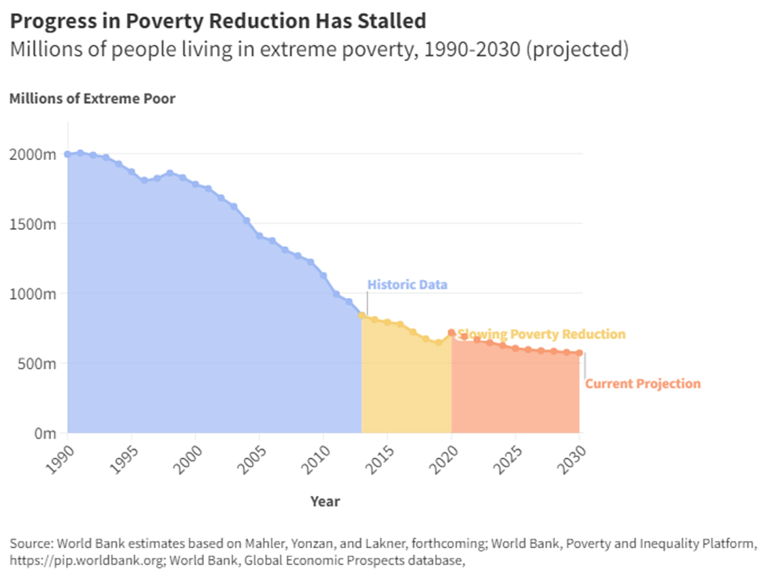
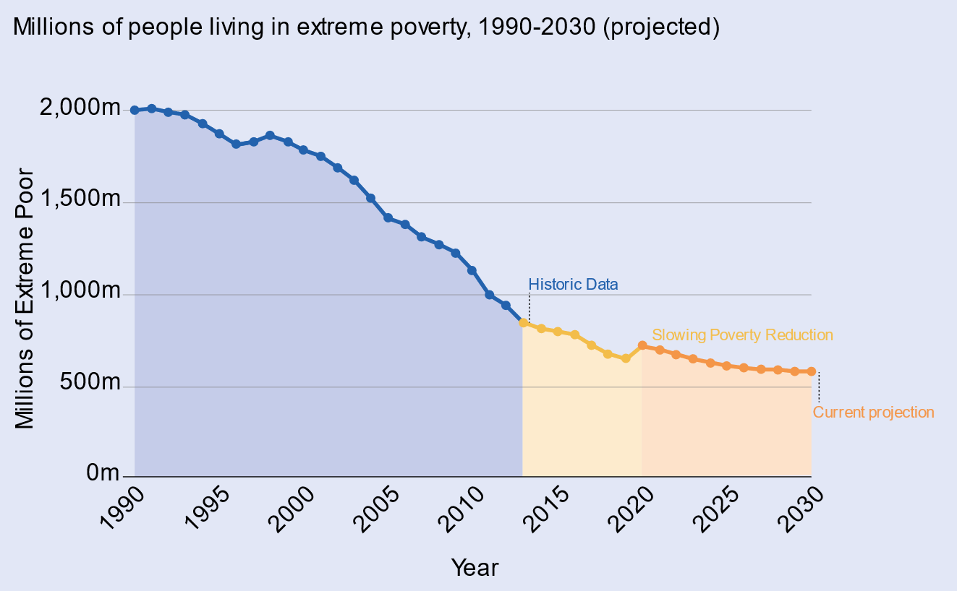
Key Message 1 - International Development in a Contested World: ending extreme poverty and tackling climate change
Context shaped this WP.
Decades of development progress [supported by improvements in key enablers]
But already challenges [poverty concentrating in hard-to-reach places; 2/3rds in FCAS by 2030].
And 2020-2022, multiple shocks and setbacks [COVID; Climate change; Conflict]
= Only 15% SDGs on-track & Developing countries falling behind & frustrated [trust deficit]. Cracks in global consensus when global cooperation is key [trade, tech, peace etc].
We need a vision shaped to this world
A key part is ‘Do int.dev well’ [morally right and key to a stable, open international order]

Slide 4
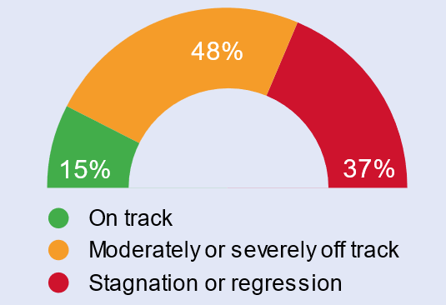
Key Message 2 - The goal of UK international development is to end extreme poverty and tackle climate change and biodiversity loss
Clear, powerful, motivating goal
Extreme poverty front and centre
Recognises there is no choice between ending extreme poverty and tackling climate change and biodiversity loss
And that achieving this goal and meeting the SDGs is only possible if all countries achieve sustainable and inclusive economic growth.

Slide 5
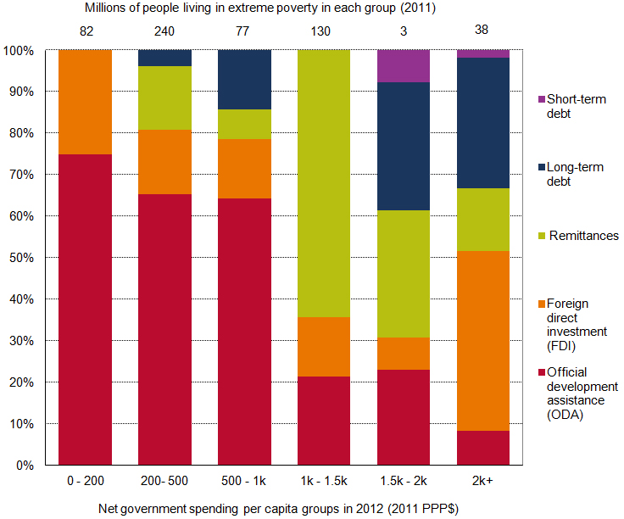
Key Message 3 – A powerful call for us to be innovative, creative and bold & use every tool and resource, including you!
Use a full range of instruments in supporting development in partner countries
Use our valuable ODA really well [where it is most needed and most effective; aim 50% of bilateral ODA for LDCs]
Draw on our investment, trade, expertise, technology, science and diplomatic capability.
Strong emphasis on multipliers and mobilizing other financial resources (Debt and equity investments e.g. BII and UKEF; guarantees).
On our development diplomacy [e.g .debt relief at Gleneagles]
On UKDev & our domestic institutions, such as UK universities (e.g. Oxford vaccine on malaria)

Slide 6
Key Message 4 – Clear how we work needs to change & an emphasis on mutual respect in our partnerships
The global context for development has changed. The UK approach to development needs to change with it.
The White Paper sets out that UK development partnerships will be guided by the principle of mutual respect.
Ownership by countries, organisations and people
Mutual accountability and learning
Mutual transparency
Common values
We will become more locally-led, and will publish a strategy on how we will put this into action.
Our partnerships will be adapted to the specific goals and needs of our partners, informed by a shared understanding of the context, objectives and what works.

Slide 7
Key Message 5 - Seven Areas for Action
Striking how many are about systemic change [patient development]
Going further, faster to mobilise international finance and increase private sector investment in development
Strengthening and reforming the international system to improve action on trade, tax, debt, tackling dirty money
Harnessing innovation and new technologies, science and research for the greatest and most cost-effective development impact
Ensuring opportunities for all, putting women and girls centre stage and investing in education and health systems that societies want
Championing action address state fragility, and to anticipate and prevent conflict, humanitarian crises, climate disasters
Building resilience and enabling adaptation for those affected by conflict, disasters and climate change, strengthening food security, social protection, and disaster risk financing
Standing up for our values, for open inclusive societies, for women and girls, and preventing roll-back of rights
Notes:
going further, faster to mobilise international finance and increase
private sector investment in development
o strengthening and reforming the international system to improve
action on trade, tax, debt, tackling dirty money and delivering on global
challenges like health, climate, nature and energy transition
o harnessing innovation and new technologies, science and research
for the greatest and most cost-effective development impact
o ensuring opportunities for all, putting women and girls centre stage
and investing in education and health systems that societies want
o championing action address state fragility, and to anticipate and
prevent conflict, humanitarian crises, climate disasters
o building resilience and enabling adaptation for those affected by
conflict, disasters and climate change, strengthening food security,
social protection, and disaster risk financing
o standing up for our values, for open inclusive societies,

Slide 8
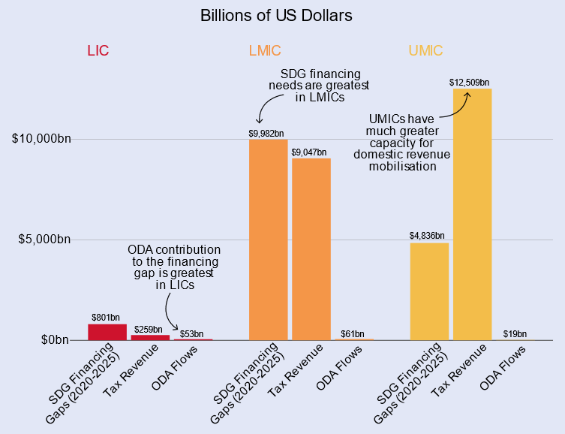
1. Mobilising International Finance
ODA resources will never come close to reaching the scale of finance required. [tension between where ODA is most critical and largest financing gap; tensions on climate finance esp. mitigation]
We want to:
Scale up financing capacity of MDBs [October 2023 MDBs announced measures unlocking $300 – $400 billion over 10 years]
Ensure poorest and most vulnerable
countries are visible and heard
Use more innovative instruments [guarantees; SDRs, CRDCs]
Mobilise private capital at scale
[pension funds]

Slide 9
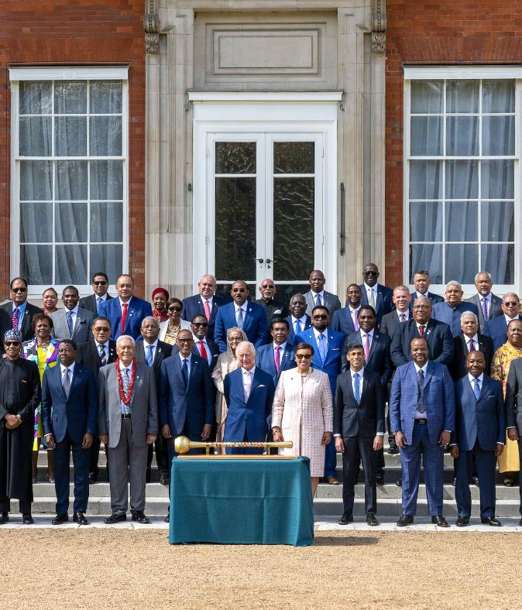
2. Reforming the International System
The international system is uniquely placed to promote universal principles and priorities.
The countries and people excluded from power in the international system need a voice in how it changes.
Working on:
Trade
Debt
Tax
Illicit finance
Remittances
Notes:
The international system is uniquely placed to promote universal principles and priorities.
A vision of a multilateral system fit for the challenges of day and tomorrow: inclusive, effective and responsive.
The countries and people excluded from power in the international system need a voice in how it changes.
Free, far and inclusive trade, within a system of transparent rules.
Leading by example in promoting debt sustainability.
Realising the potential benefits for low-and middle-income countries from the global tax rules.
A long-term approach to tackling illicit finance.
Reducing the costs of remittances.

Slide 10
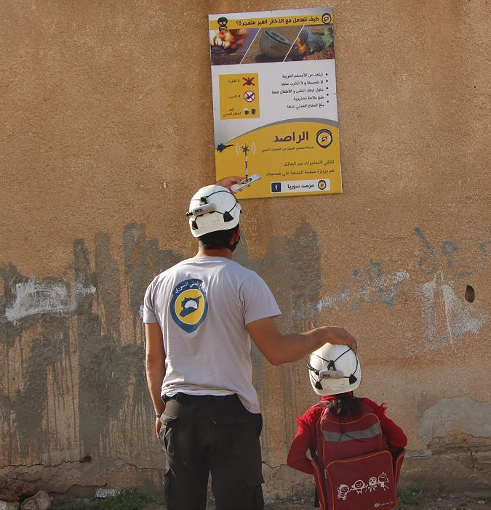
3. Harnessing innovation
Research, innovation and new technologies are a key part of reducing poverty and enabling the green energy transition.
We need a collective global mobilisation of scientific expertise, research and innovation, driving breakthroughs
We want to see inclusive, responsible and sustainable digital transformation.
Localised Partnership: International Science Partnerships Fund
Notes:
Research, innovation and new technologies are a key part of reducing poverty and enabling the green energy transition.
Across climate, social protection, health, water, food, disasters and humanitarian response, conflict, and so much more, science and technology has a key role to play.
We need a collective global mobilisation of scientific expertise, research and innovation, driving breakthroughs, leap-frogging phases of industrial development, and creating sustainable economic growth.
Our science and research partnerships must be equitable and predictable.
We want to see inclusive, responsible and sustainable digital transformation.
We need to reach the 2.6 billion people who remain offline, and solve the problem of last-mile connectivity.

Slide 11
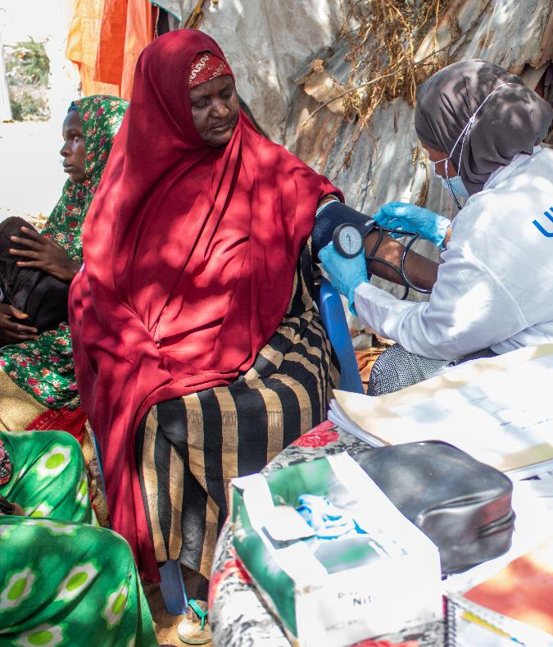
4. Ensuring opportunities for all
Our vision is to achieve gender equality and the autonomy of all women and girls
Focus of UK campaigns; &
Programme target: at least 80% of FCDO’s bilateral aid programmes have a focus on gender equality by 2030].
Educating girls is a long-standing top development priority for the UK, our vision is to see transformed education systems providing quality teaching and learning outcomes.
We want everyone, everywhere to have affordable access to the essential health services they need.
All countries able to establish and sustain water, sanitation and hygiene services that are reliable, resilient and inclusive.
Notes:
Tackling inequality could secure huge benefits. Unlocking the full potential and power of women and girls accelerates progress on all the UK’s global priorities.
Our vision is to achieve gender equality and the autonomy of all women and girls.
Educating girls is a long-standing top development priority for the UK, our vision is to see transformed education systems providing quality teaching and learning outcomes.
We want everyone, everywhere to have affordable access to the essential health services they need.
All countries able to establish and sustain water, sanitation and hygiene services that are reliable, resilient and inclusive.

Slide 12
5. Championing action to anticipate and prevent crisis
Urgent action is needed to reduce emissions in line with 1.5C pathway.
Our vision is for more ambitious climate policies, and just, sustainable, and clean transitions in energy, forests, food, the ocean and land use.
Sustainable and inclusive growth that reduces poverty while preserving nature and natural assets.
Supporting early warning systems
A foundation of peace and security.
Humanitarian crises are diminished and prevented.
A food secure future.
Notes:
Urgent action is needed to reduce emissions in line with 1.5C pathway.
More ambitious climate policies, and just, sustainable, and clean transitions in energy, forests, food, the ocean and land use.
Supporting the early warning systems to support countries’ resilience.
Sustainable and inclusive growth that reduces poverty while preserving nature and natural assets.
Development requires a foundation of peace and security; our vision is for international efforts that combine development, diplomatic and security to reduce conflict.
Our vision is that humanitarian crises are diminished and prevented, humanitarian need and famine risks have reduced, and humanitarian aid is a last resort.
We want a food secure future, where chronic and acute insecurity and malnutrition are significantly reduced, ideally eliminated.

Slide 13
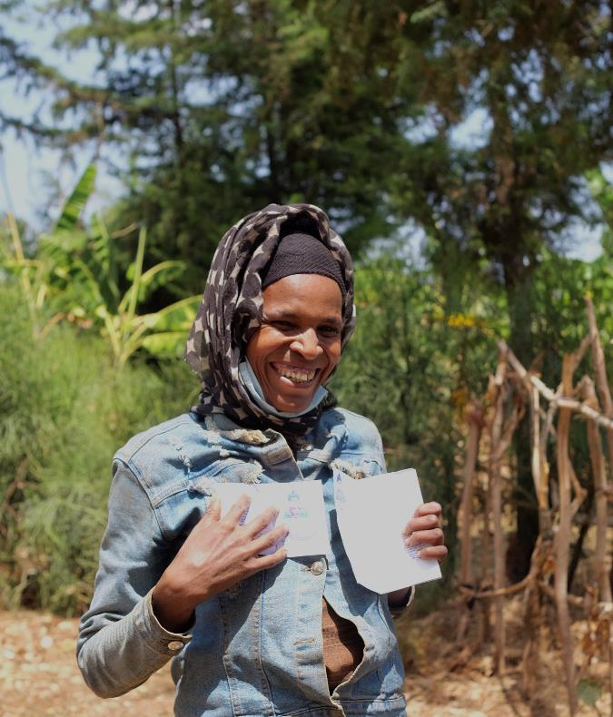
6. Building resilience and enabling adaptation
Helping countries adapt to the impacts of climate change; health, food, water.
More people to be supported by inclusive national social protection systems.
Safe, orderly, and legal migration. We want to step up global action on forced displacement.
It is quicker and more efficient to act on disasters in advance.
Pre-arranged finance, such as insurance, ensures fast disbursements and minimises economic scarring
Notes:
Helping countries adapt to the impacts of climate change; health, food, water.
A world where hundreds of millions more people are supported by inclusive national social protection systems.
There are an estimated 281 million migrations worldwide. Our vision is for safe, orderly, and legal migration. We want to step up global action on forced displacement.
A major shift is needed to help countries prepare for and respond to disasters. It is quicker and more efficient to act in advance.
Pre-arranged finance, such as insurance, ensures fast disbursements and minimises economic scarring

Slide 14
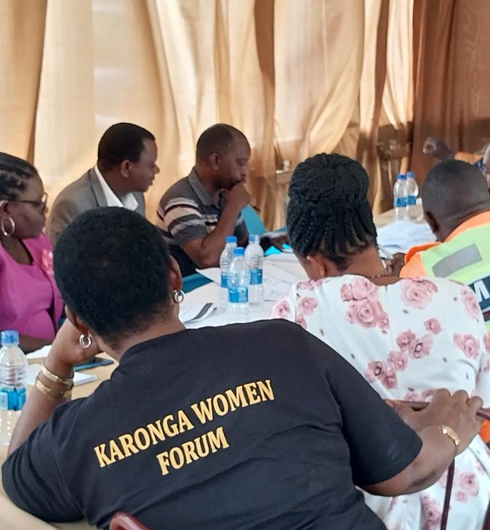
7. Standing up for our values
The UK defends and promotes human rights, the rule of law and accountable institutions.
Leaving no-one behind - a guiding value of UK international development.
Doubling our bilateral support for low-income countries next year, including increasing support to Africa from £646m in 2023-24 to £1.364bn in 2024-25
We’re committed to unlocking the full potential and power of women and girls
Open societies and accountable institutions have enabled progress
Concerted action to tackle sexual exploitation and abuse and harassment
Notes:
The UK defends and promotes human rights, the rule of law and accountable institutions.
Leaving no-one behind remains a guiding value of UK international development.
We’re committed to unlocking the full potential and power of women and girls, to accelerate progress on all global development priorities.
Open societies and accountable institutions have enabled progress, but challenges to open societies and human rights are increasing.
A vision for an increasing number of open societies, with more people living in countries with accountable, effective and inclusive institutions.
The role of independent media must be promoted and protected, and we must defend civic space, including working with local organisations.
Committed to concerted action to tackle sexual exploitation and abuse and harassment

Slide 15
UK Development Strategy On A Slide
Patient Development and Diplomacy: Building on the direction set in the International Development Strategy, we deliver a distinct UK offer within this framework for action:
Our National Interest
Our commitment to international development forms part of a coherent UK international approach. It is both morally right and protects our interest in an open and stable international order, and in the sovereignty, security and prosperity of the British people.
Long Term: We take the long view, invest in reliable and equitable relationships and support the effective institutions and critical capabilities central to delivering lasting development outcomes.
Our Strategic
Goal
To end extreme poverty and tackle climate change and biodiversity loss. Achieving this goal and meeting the UN Sustainable Development Goals (SDGs) is only possible if all countries achieve sustainable and inclusive economic growth.
Global Partnership: We listen to the asks of partner countries and work together to promote global action on issues critical to the SDGs through our global campaigns. We champion inclusive multilateralism, supporting stronger representation for those excluded.
Our Key Areas of Action:
For global partnerships to progress the SDGs:
Mobilising the money to finance development
Strengthening & reforming the international system
Harnessing innovation, new technologies, science and research.
Ensuring opportunities for all
Champion action to address state fragility, anticipate and prevent crises
Building resilience & enabling adaptation
Standing up for our values
Mutual Respect: We respond to locally owned priorities and contexts and deliver through local institutions as far as possible. We support mutual accountability and transparency. We are open about our values but respect that not all our partners will share these and seek common ground.
These priorities are central to the FCDO’s Outcome Delivery Plan and are reflected in delivery plans across Government.
Best of Britain: We draw on all of Government, our private sector and civil society and use all our levers, from our expertise to our finance, to deliver. Our grant aid is focused on the poorest and most vulnerable.
Our Strategic
Thread
Our commitment to the UN Sustainable Development Goals as our guiding vision, and to a distinct UK offer, built around patient and mutually respectfully partnerships, sits across everything we do.

