Slide 1
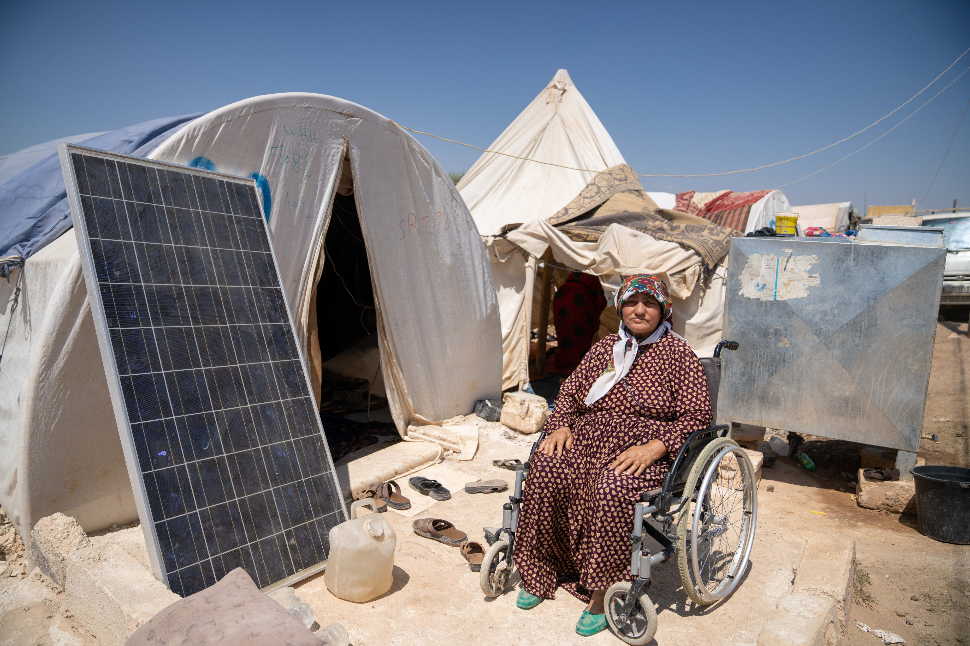
ID CPG
Jan 2024
Notes:
We want to tell you a bit about our work, the amazing impact it’s having, and has had over 60 years
We’re delighted that a number of councils here have already supported our work
We hope we can persuade others to lend us your voices to shout when local communities around the world need immediate, international support and solidarity

Slide 2
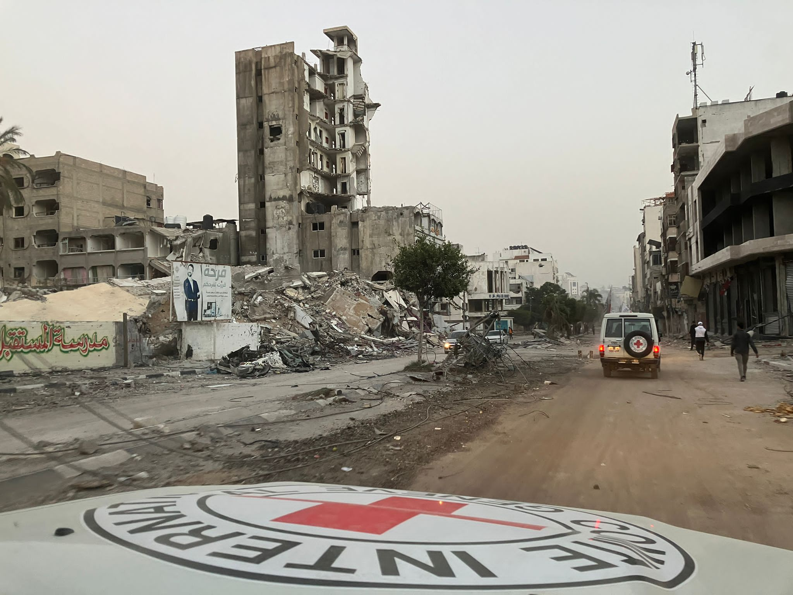
Gaza Update
No DEC Appeal as yet. Criteria 2 not met
Inability to deliver significantly more aid into Gaza.
Some member charities are supporting long-term partners in Gaza and/or pre-positioning stock
Scottish Government has committed £750,000 to UNRWA

Slide 3
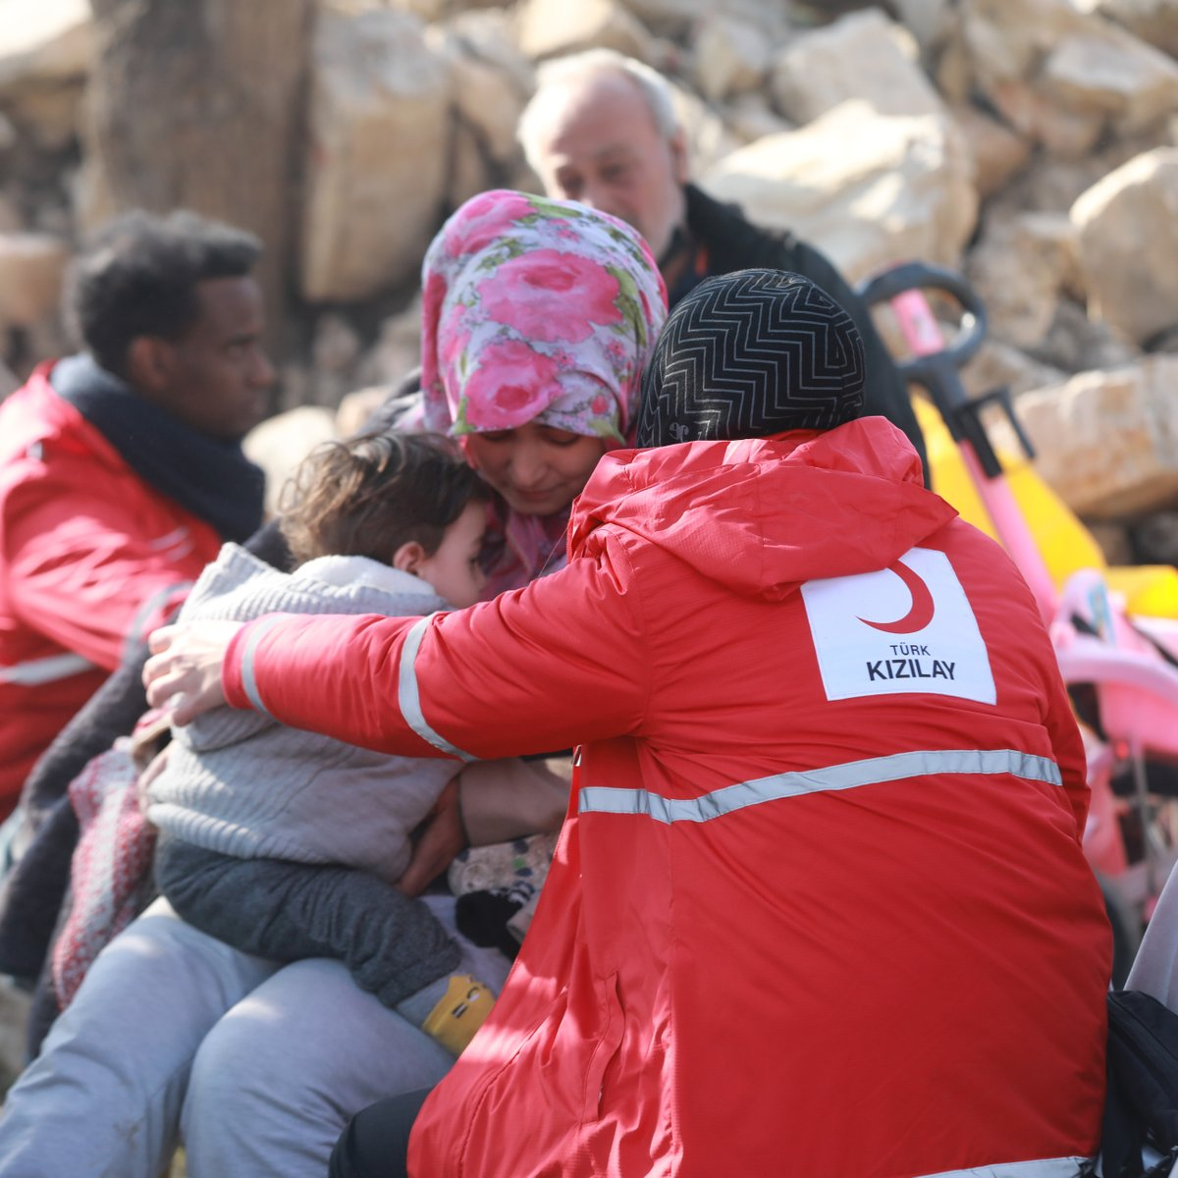
1st anniversary of disaster in early Feb
£150 million raised – £15 million here in Scotland
£500,000 funding from SG
Phase 1: 14 DEC charities and local partners initially providing emergency shelter, food and water.
Phase 2: Until Jan 2025 – more cash and livelihood support.

Slide 4
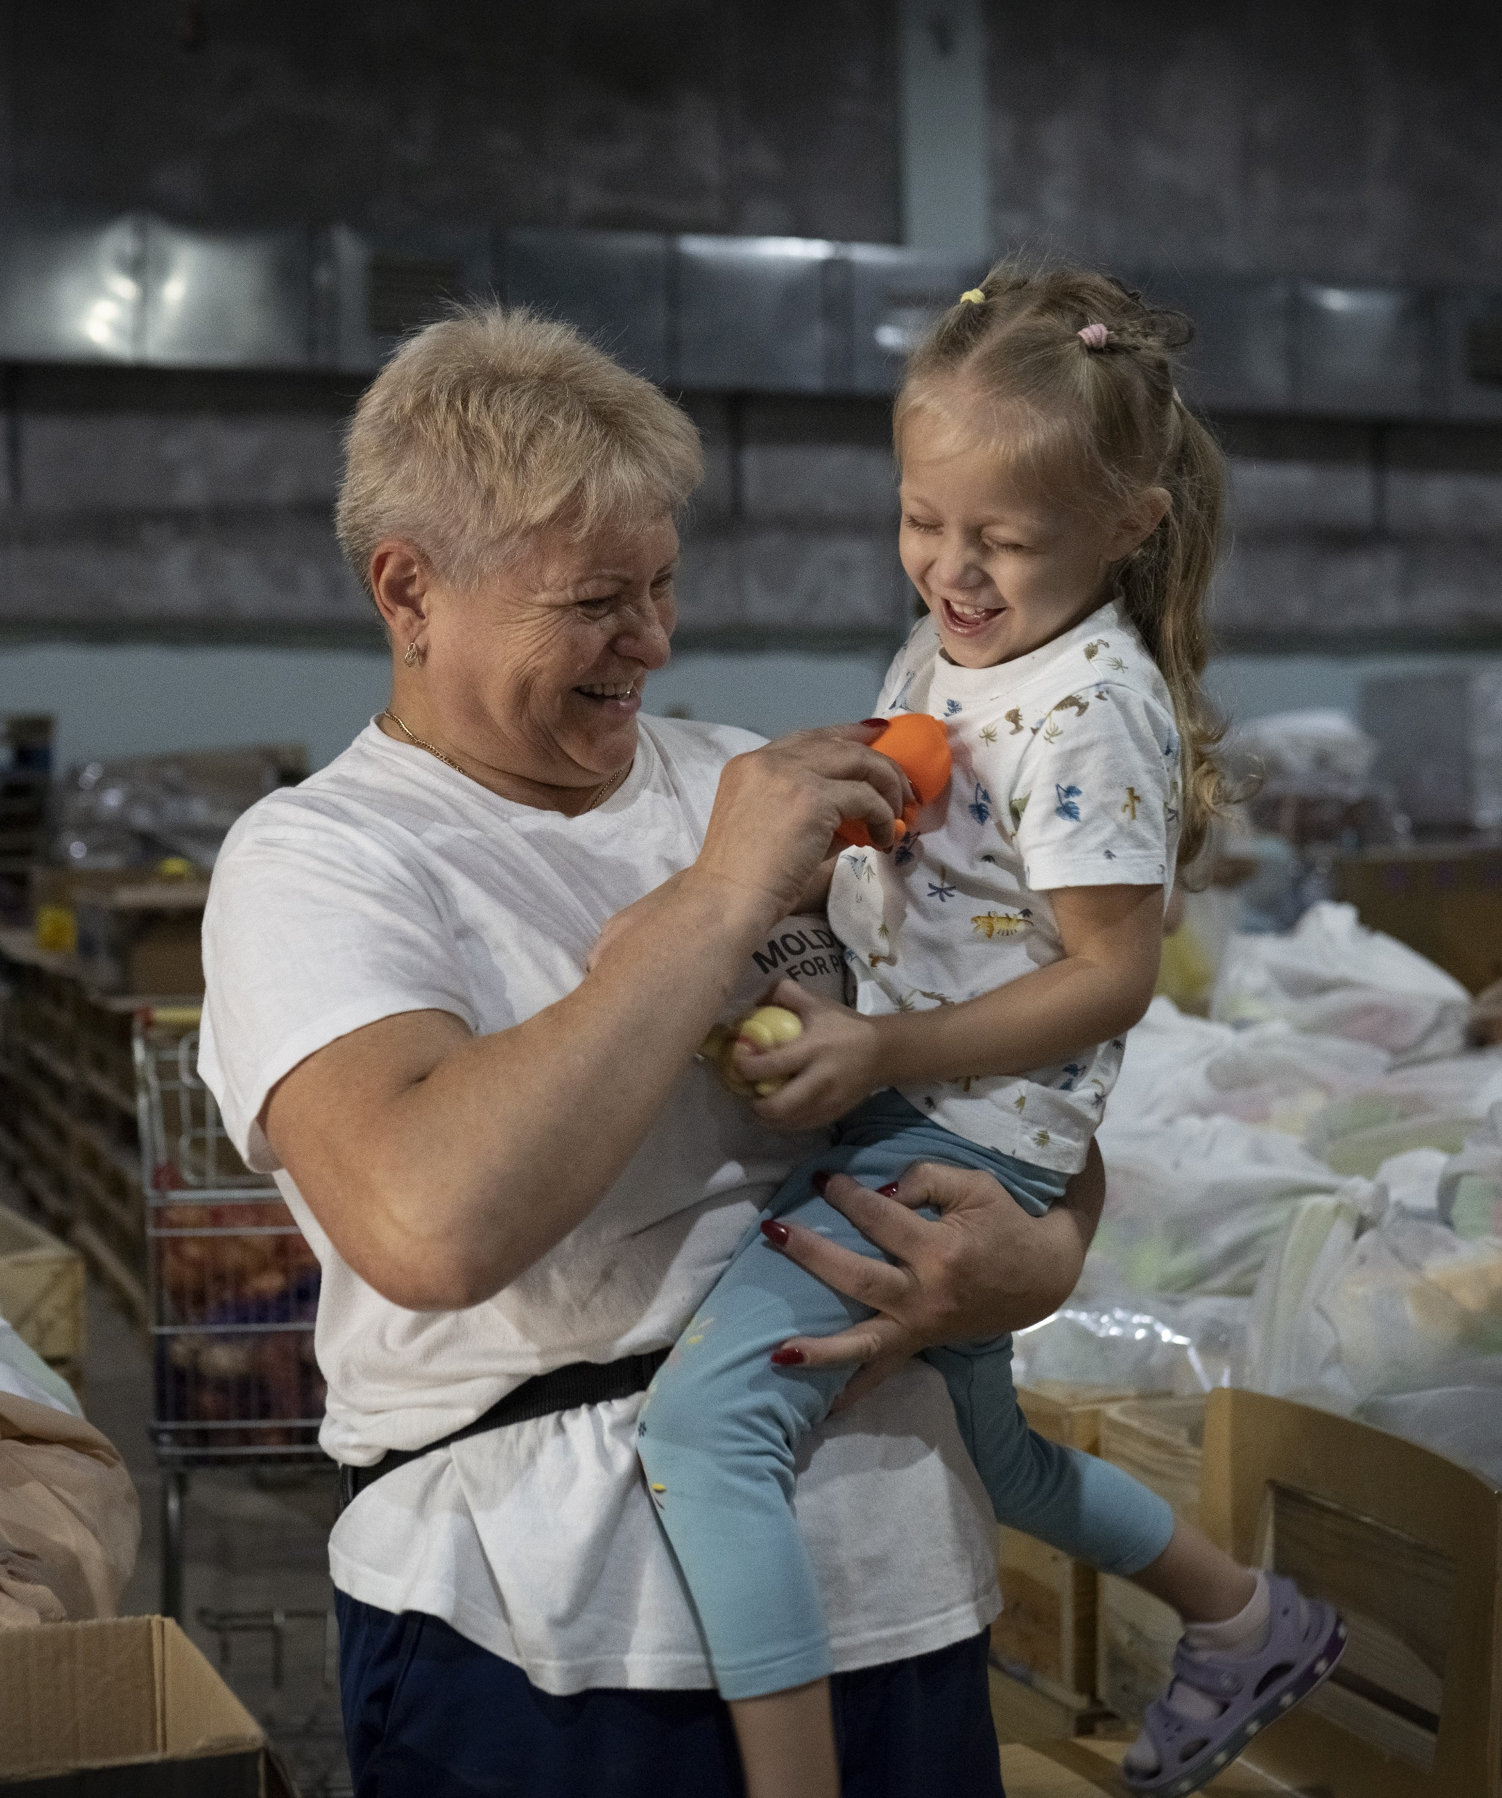
2nd anniversary of conflict approaching
2nd largest Appeal in DEC’s history, more than £420 million raised, £38 million raised here in Scotland
DEC charities and partners will continue to provide range of support, not only in Ukraine but also Poland, Romania, Moldova and Hungary until Feb 2025
Ukraine 1 year report

Slide 5
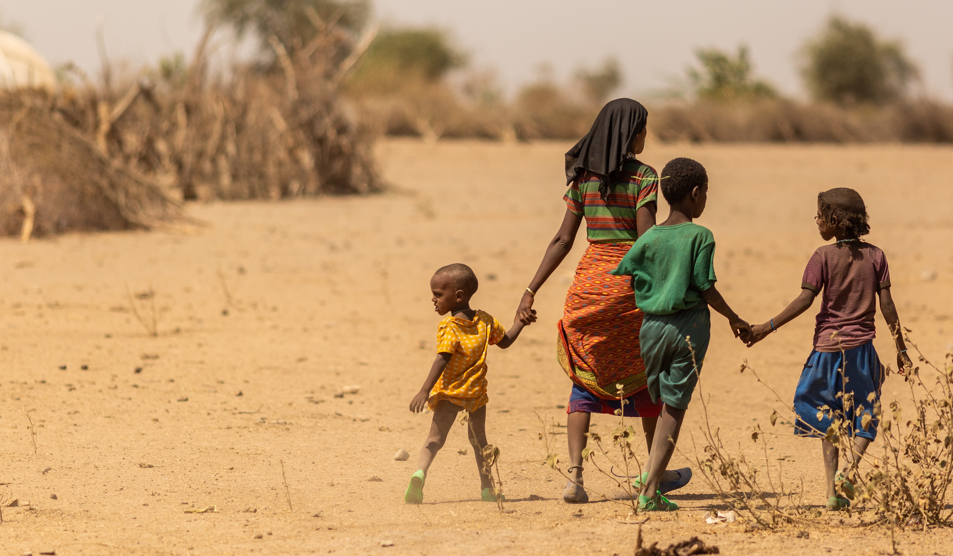

Slide 6
HEF Projects 2023
Sudan
£250,000 shared between British Red Cross and Oxfam as civil war continues
Afghanistan
£250,000 shared between SCIAF and Christian Aid following October earthquake
Libya
£250,000 shared between Islamic Relief and BRC following flash flood in Derna

Slide 7
Loss and Damage
Additional £1 million has been allocated to HEF members from SG Climate Justice Fund
£250,000 for SCIAF in Zambia
£250,000 for Christian Aid in Ethiopia
£250,000 for Oxfam in Kenya
£250,000 each for Tearfund in Pakistan
Assessment of these pilot projects in tackling both economic and non-economic loss

Slide 8
Humanitarian Outlook 2024
Global humanitarian needs remain at all time high – just under 300 million people in 2024
3 main ‘drivers’ of this continuing surge – conflict, climate and related economic pressures
1 in 5 children in or fleeing from conflict, 1 in 73 people have been forcibly displaced from home
Key UN body, OCHA asking for $46.4 billion to assist 180.5 million people across 72 countries.
UN OCHA Global Humanitarian Overview 2024

