Slide 1
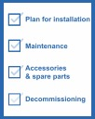



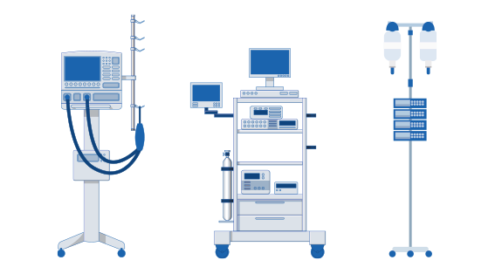


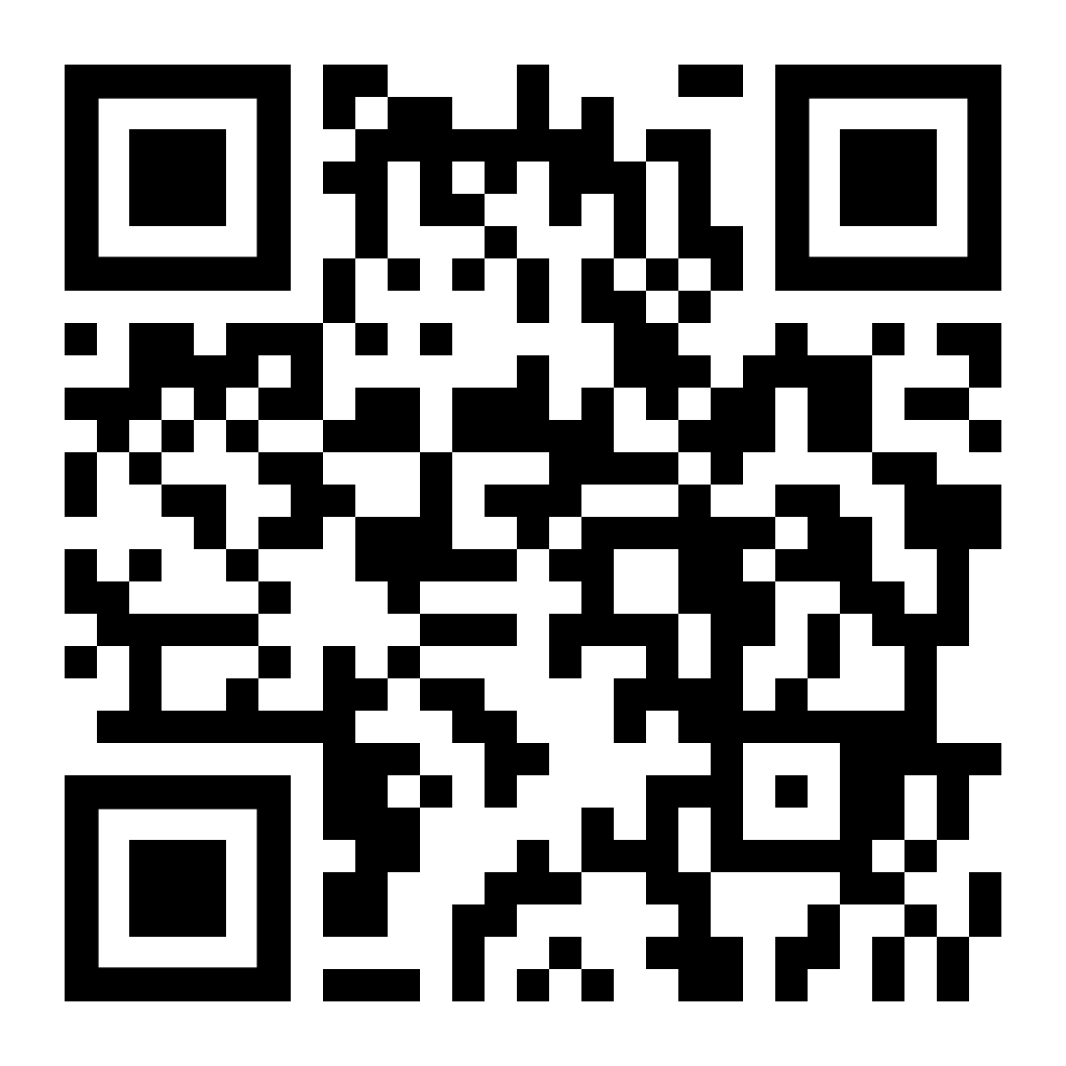
10 Steps to Safe Medical Equipment Donations
The steps along the journey to making a donation of medical equipment are below.
Each step can include more than one action and the steps do not have to be followed
in order. Review all 10 steps when you receive a request.
Your partner has identified a need and made a donation request to you. Communicate with the hospital/person making the request to fully understand what they want. Undertake the relevant training and read the available guidance (THET Making it Work, WHO Guidelines, PQMD and Scotland Malawi donation guidance)
Are the necessary plans in place for installation, maintenance, accessories & spare parts and decommissioning? If this has not been possible then you cannot be certain the equipment will be safe for use once it arrives. Until this is resolved you should stop the process of making a donation.
1.
5.
Plan for logistics of transportation, ensuring you have all the documents needed for customs clearance. If this has not been possible then you cannot
be certain that the donation will arrive safely. You should stop until this is fully resolved.
Liaise with your partner, read ‘Managing the Lifecycle of Medical Equipment’ and talk to the local technical expert in the hospital/setting to ensure they understand what has been agreed to be sent and that they are able to maintain it.
6.
2.
Discuss and agree an end-of-life plan for the donation so it will be safely disposed of.
Seek final confirmation that the donation is still required and confirm that everything has been done.
Stop and reflect. Are you able to fulfil the requirements for an effective, ethical, sustainable, and safe donation as set out in the best practice guidance referred to in previous steps? Are there any elements you are unable to fulfil?
7.
8.
If there are then you should stop the donation process. Donating medical equipment in an unsafe way can do more harm than good.
3.
Follow up, feed back and evaluate, through an agreed process as partners.
Make the donation
Is your donation new or second-hand equipment?
Do you have all the necessary manuals and an agreed plan
for consumables and maintenance with the hospital?
10.
9.
4.
Notes:
Œ

